Slide 1
Metro Station Optimization Using Reinforcement Learning
DSAN 6650
Ihsan Alaeddin, Manav Arora, Jessica Joy, Shanay Wadhwani

Slide 2
Agenda
01
Add section title
Slide 00
02
Add section title
Slide 00
03
Add section title
Slide 00
04
Add section title
Slide 00
05
Add section title
Slide 00
06
Add section title
Slide 00
Confidential

Slide 3
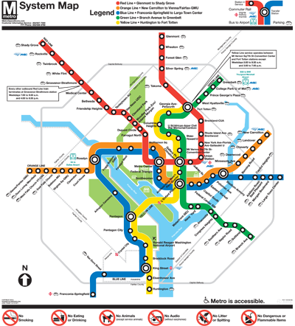
Motivation
Confidential

Slide 4
Write a brief, inspiring summary of the campaign. Get your audience excited about it. For now, focus on the big picture. You can dive into more detail later.
CAMPAIGN OVERVIEW
Confidential

Slide 5







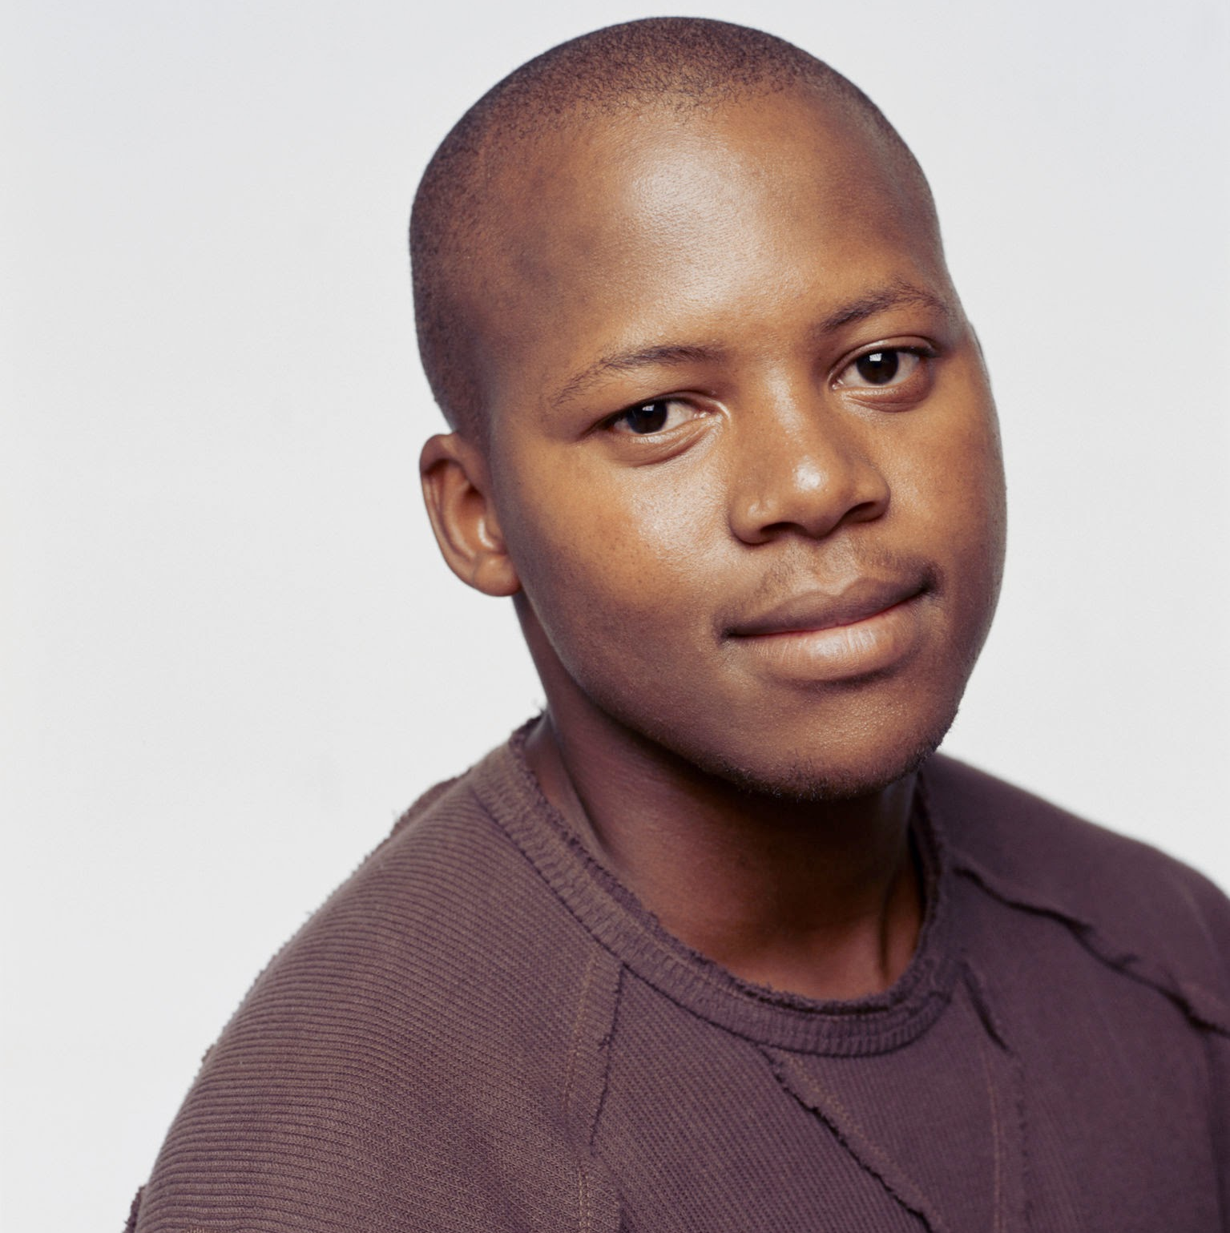
Meet the team
Full Name
Full Name
Full Name
Full Name
Title
Title
Title
Title
Full Name
Full Name
Full Name
Full Name
Title
Title
Title
Title
Confidential

Slide 6
Write a persuasive statement about the current market or industry context
Explain why your campaign or marketing plan is relevant, right now.
Think about the challenges your market or industry is facing, and justify the need for your plan.
Confidential

Slide 7
Share your campaign objectives
Objective 1
Objective 2
Objective 3
In light of the market or industry context you just described, list the goals of your marketing plan or campaign.
One of your objectives might be to grow market share or generate leads. Express these goals in the form of key performance indicators (KPIs).
Mention as many objectives as you want. Consider what is feasible and relevant to your business. Duplicate this slide if you need more space.
Confidential

Slide 8
Business objectives
Now that you’ve described your campaign objectives, explain how they lead up to your long-term business goals. Use the graph to visualize your point.
Expand market footprint
Increase revenue
Acquire new customers
Campaign objective 1
Campaign objective 2
Campaign objective 3
Confidential

Slide 9
Business objectives
Now that you’ve described your campaign objectives, explain how they lead up to your long-term business goals. Use the graph to visualize your point.
Campaign objective 1
Campaign objective 2
Campaign objective 3
Increase revenue
Acquire new customers
Expand market footprint
Confidential

Slide 10

A keen observation about your personas or target audiences
PERSONA NAME
Introduce your audience persona, who they are, and where they come from. Mention their age and profession.
Needs and motivations
What does your persona want or need to achieve? What are their goals? And what motivates them to pursue these goals?
Pain points
Describe an obstacle your persona struggles with. Think about what interferes with their needs, goals, and motivations.
How we can help
Now this is where your product or service comes in. Think about how it helps them achieve their goals and solve their pain points.
Confidential

Slide 11
Persona name
“Quote the persona on their needs and wants. This can be a fictional line or an excerpt from a real user interview.”
ATTRIBUTES
GOALS & NEEDS
Age
23
BIO
Occupation
Job title
Status
Single
FRUSTRATIONS
Education
College degree
Location
Place name
Archetype
Book club
Attribute
Attribute
Attribute
Attribute
What do they want to achieve and why?
What do they want to achieve and why?
What do they want to achieve and why?
Introduce your persona, who they are and where they come from. Think about a hypothetical user or customer who represents an audience segment. Although the individual might be fictional, the insights should be derived from your audience research.
What specific obstacles are they facing?
What specific obstacles are they facing?
What specific obstacles are they facing?
Confidential

Slide 12
Persona name
BEHAVIORS
CHALLENGES
TECHNICAL SKILLS
Specific skill, device, or app
Specific skill, device, or app
Specific skill, device, or app
PERSONALITY
MOTIVATIONS
Specific skill, device, or app
Extrovert
Introvert
Driver 1
Specific skill, device, or app
Spontaneous
Planner
Driver 2
FAVORITE BRANDS
Collaborative
Independent
Driver 3
CURRENT FEELINGS
FAVORITE APPS
What are their daily habits?
What are their daily habits?
What are their daily habits?
What influences their decisions or priorities?
What influences their decisions or priorities?
What influences their decisions or priorities?
Logo
Logo
Logo
Logo
Logo
Logo
Frustrated
Hopeful
Logo
Logo
Logo
Confidential

Slide 13
Competitive analysis
Feature 1
Feature 1
Feature 1
Feature 1
Feature 1
Feature 1
Feature 1
Feature 1
Product 1
Product 2
Product 3
Product 4
0
(WORST)
1
2
3
4
5
6
7
8
9
10
(BEST)
Confidential

Slide 14

Key learnings and opportunities
Based on your analysis of the competitive landscape, write a brief summary of the business opportunities you’ve identified.
Confidential

Slide 15
Customer journey
Step 1
Step 2
Step 3
Step 4
Step 5
Outline the customer journey, one step at a time. Mention touchpoints, user actions, or any other relevant moments.
Outline the customer journey, one step at a time. Mention touchpoints, user actions, or any other relevant moments.
Outline the customer journey, one step at a time. Mention touchpoints, user actions, or any other relevant moments.
Outline the customer journey, one step at a time. Mention touchpoints, user actions, or any other relevant moments.
Outline the customer journey, one step at a time. Mention touchpoints, user actions, or any other relevant moments.
Confidential

Slide 16





Customer journey
Stages
Actions
Emotions
Pain points
Touch points
Opportunities
Stage 1
Stage 2
Stage 3
What specific actions do customers execute during this stage?
What specific actions do customers execute during this stage?
What specific actions do customers execute during this stage?
What specific actions do customers execute during this stage?
What specific actions do customers execute during this stage?
What specific actions do customers execute during this stage?
What challenges or frustrations do they encounter?
What challenges or frustrations do they encounter?
What challenges or frustrations do they encounter?
What challenges or frustrations do they encounter?
What challenges or frustrations do they encounter?
What challenges or frustrations do they encounter?
What challenges or frustrations do they encounter?
What challenges or frustrations do they encounter?
What challenges or frustrations do they encounter?
Where do customers interact with your product or service?
Where do customers interact with your product or service?
Where do customers interact with your product or service?
Where do customers interact with your product or service?
Where do customers interact with your product or service?
Where do customers interact with your product or service?
Where do customers interact with your product or service?
Where do customers interact with your product or service?
Where do customers interact with your product or service?
In what ways can you improve the customer experience?
In what ways can you improve the customer experience?
In what ways can you improve the customer experience?
In what ways can you improve the customer experience?
In what ways can you improve the customer experience?
In what ways can you improve the customer experience?
In what ways can you improve the customer experience?
In what ways can you improve the customer experience?
In what ways can you improve the customer experience?
Confidential

Slide 17
A claim about the role of marketing channels in your campaign
Channel name
Channel name
Channel name
Channel name
Describe the channel and what role it will play in your campaign.
Audience
Identify the segment you hope to reach.
Actions Explain what you will do to reach your target. For example, it could be a video ad, a viral post, thought leadership content, etc.
Goal
Share your marketing objectives or calls to action.
Describe the channel and what role it will play in your campaign.
Audience
Identify the segment you hope to reach.
Actions Explain what you will do to reach your target. For example, it could be a video ad, a viral post, thought leadership content, etc.
Goal
Share your marketing objectives or calls to action.
Describe the channel and what role it will play in your campaign.
Audience
Identify the segment you hope to reach.
Actions Explain what you will do to reach your target. For example, it could be a video ad, a viral post, thought leadership content, etc.
Goal
Share your marketing objectives or calls to action.
Describe the channel and what role it will play in your campaign.
Audience
Identify the segment you hope to reach.
Actions Explain what you will do to reach your target. For example, it could be a video ad, a viral post, thought leadership content, etc.
Goal
Share your marketing objectives or calls to action.
Confidential

Slide 18
A claim about the role of marketing channels in your campaign
Content marketing
Channel
name
Channel
name
Channel
name
Channel
name
Campaign
Channel
name
Social
media
Channel
name
Channel
name
Offline
channels
Channel
name
Channel
name
Channel
name
Channel
name
Channel
name
Other
Confidential

Slide 19
A claim about the role of marketing channels in your campaign
Content marketing
Offline channels
Channel name
Description, asset types, etc.
Channel name
Description, asset types, etc.
Channel name
Description, asset types, etc.
Channel name
Description, asset types, etc.
Channel name
Description, asset types, etc.
Channel name
Description, asset types, etc.
Channel name
Description, asset types, etc.
Channel name
Description, asset types, etc.
Channel name
Description, asset types, etc.
Channel name
Description, asset types, etc.
Channel name
Description, asset types, etc.
Channel name
Description, asset types, etc.
Social media
Other
Confidential

Slide 20
How we’ll measure the success of the campaign
Channel name
Channel name
Channel name
Channel name
Now introduce the key performance indicators (KPIs) for each channel. You might have a single KPI or several. List them out like this:
Now introduce the key performance indicators (KPIs) for each channel. You might have a single KPI or several. List them out like this:
Now introduce the key performance indicators (KPIs) for each channel. You might have a single KPI or several. List them out like this:
Now introduce the key performance indicators (KPIs) for each channel. You might have a single KPI or several. List them out like this:
KPI 1
KPI 1
KPI 1
KPI 1
KPI 2
KPI 2
KPI 2
KPI 2
KPI 3
KPI 3
KPI 3
KPI 3
Confidential

Slide 21
How we’ll measure the success of the campaign
Platform
KPIs
Platform name
XXB
KPI 1
KPI 2
KPI 3
KPI 4
Platform name
XXB
KPI 1
KPI 2
KPI 3
KPI 4
Platform name
XXB
KPI 1
KPI 2
KPI 3
KPI 4
Platform name
XXB
KPI 1
KPI 2
KPI 3
KPI 4
Platform name
XXB
KPI 1
KPI 2
KPI 3
KPI 4
Platform name
XXB
KPI 1
KPI 2
KPI 3
KPI 4
Confidential

Slide 22
Launch timeline
Month
Month
Month
Month
Month
Month
Month
CAMPAIGN STAGE
Summarize what will happen during this stage of the campaign. Think about production steps or marketing actions.
CAMPAIGN STAGE
Summarize what will happen during this stage of the campaign. Think about production steps or marketing actions.
CAMPAIGN STAGE
Summarize what will happen during this stage of the campaign. Think about production steps or marketing actions.
WE’RE HERE
Start date/End date
Start date/End date
Start date/End date
Start date/End date
CAMPAIGN STAGE
Summarize what will happen during this stage of the campaign. Think about production steps or marketing actions.
Confidential

Slide 23

Campaign stage: Planning and development
In a few lines, explain what needs to happen during the opening stages of the campaign.
For example, you might have to set goals, agree on a budget, develop your media strategy, build a team, etc.
You can talk about each step in paragraphs or bullet points. Whatever is clearest for your audience.
Confidential

Slide 24

Campaign stage: Execution and launch
With the planning out of the way, it’s time to make the campaign a reality.
Depending on the nature of your campaign, this might involve:
Creating your marketing content
Hiring external contractors
Partnering with influencers
Securing online or offline advertising space
Confidential

Slide 25

Campaign stage: Monitoring and analysis
Now that the campaign has reached its final stages, what needs to happen before it wraps up?
You might need to analyze your key performance indicators, hold a retrospective with the team, or review your budget.
Alternatively, your campaign might not have a definite end point. It might include post-launch updates or a long-term content pipeline. Mention that here, too.
Confidential

Slide 26
Budget
Low budget
Mid budget
High budget
Phase 1
$00
$00
$00
Phase 2
$00
$00
$00
Phase 3
$00
$00
$00
Total
$00
$00
$00
Confidential

Slide 27
Next steps
Step 1
Describe an upcoming step or phase in the marketing plan or campaign.
Step 2
Steps can include further deliveries, check-ins, extensions to the current campaign, etc.
Step 3
Add as many steps as you want or need for your marketing plan. Duplicate this slide if you need more steps.
Confidential

Slide 28
Thank you!
Contact our team
name@example.com
Confidential

